Slide 1


TASK 4 : SYSTEM DESIGN
FEEDBACK COLLECTION APPLICATION
Presentation by Group 5

Slide 2


OVERVIEW
Part 1
Part 2
System Design
UML Diagrams

Slide 3

WHAT IS SYSTEM DESIGN?
System design refers to the structured planning and organization of how a mobile application or mobile-based service will function, communicate, and scale.
It encompasses both the architecture of the system and the interaction between its components.

Slide 4

Functional Requirements
Recall our core requirements as:
FR1: Background Metrics Collection
FR3: User Feedback System
FR5: Data Management & Transmission
FR7: Settings & Permissions Management

Slide 5
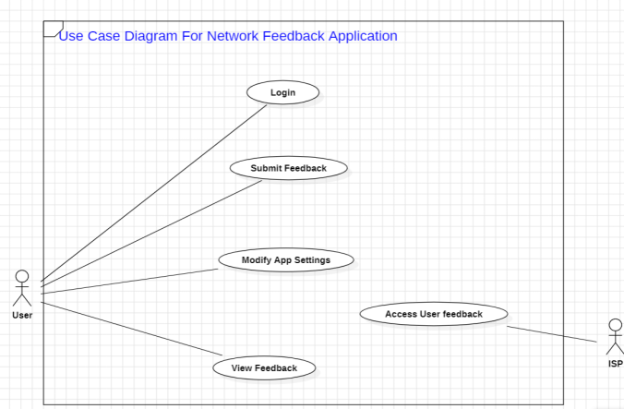
USE CASE
Actors
The Use Case Diagram illustrates interactions among Users, ISPs, and Servers.
Interaction - Users
Users can register, submit feedback, modify settings, and view feedback.
Interaction - ISPs
ISPs manage feedback information and access user feedback.

Slide 6
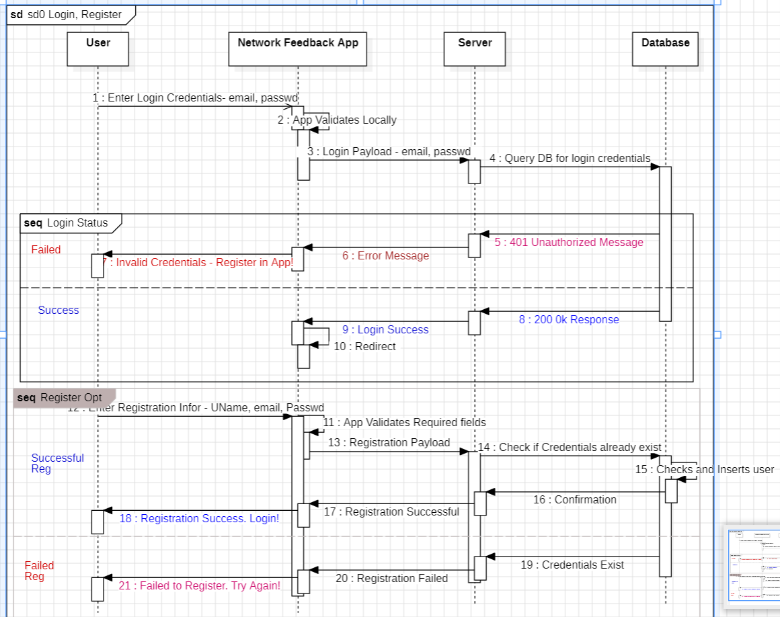
SEQUENCE DIAGRAMS
Login/Register Sequence
details the login process, involving credential validation by the app and the server.

Slide 7
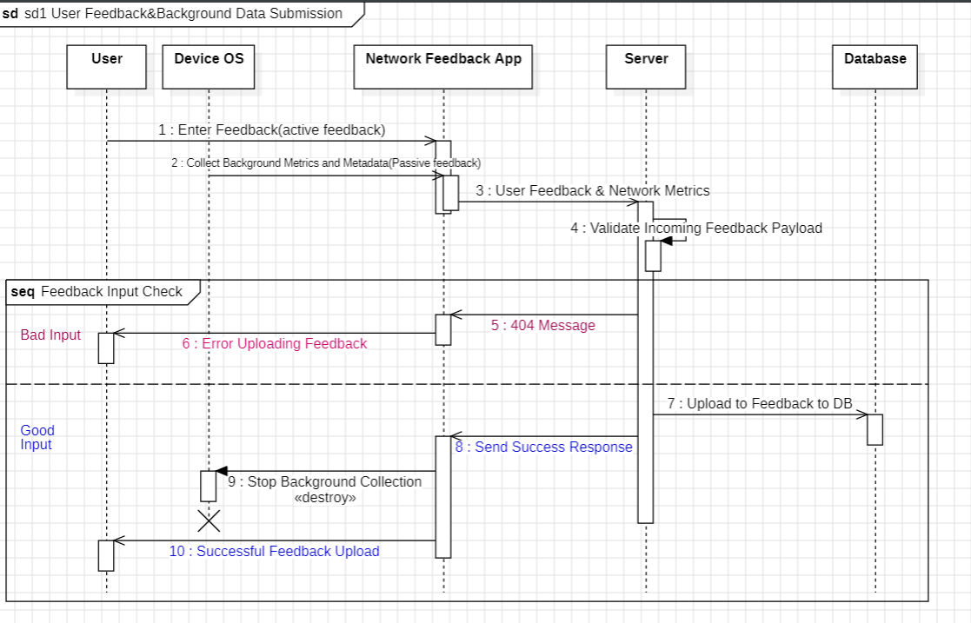
SEQUENCE DIAGRAMS
Feedback Submission
describes how the user submits feedback, with validation and response handling.

Slide 8
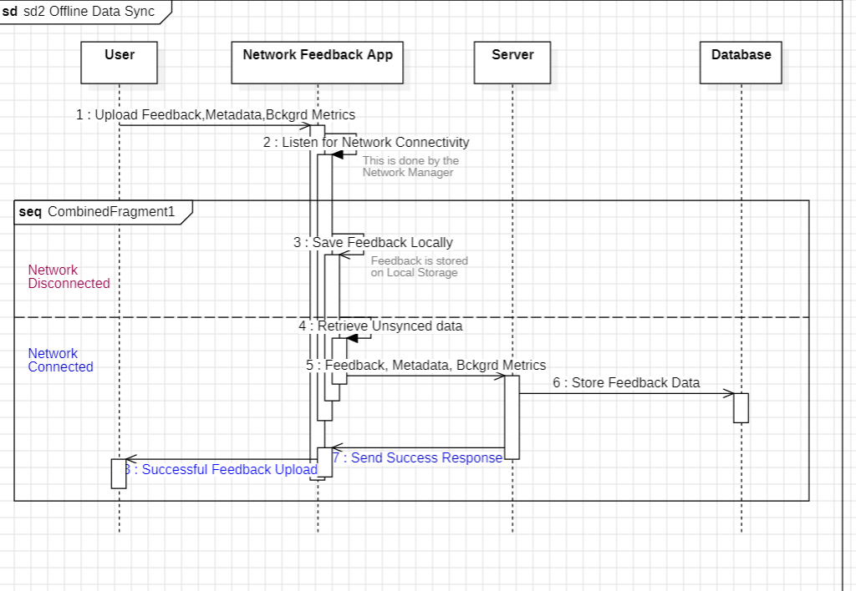
SEQUENCE DIAGRAMS
Offline Data Sync
describes how the user submits feedback, with validation and response handling.

Slide 9
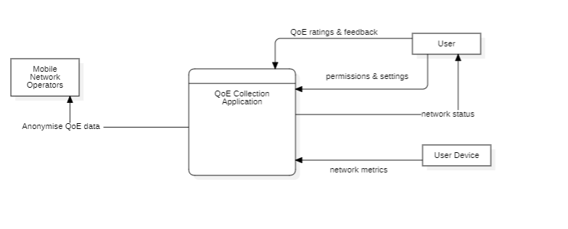
CONTEXT DIAGRAM

Slide 10
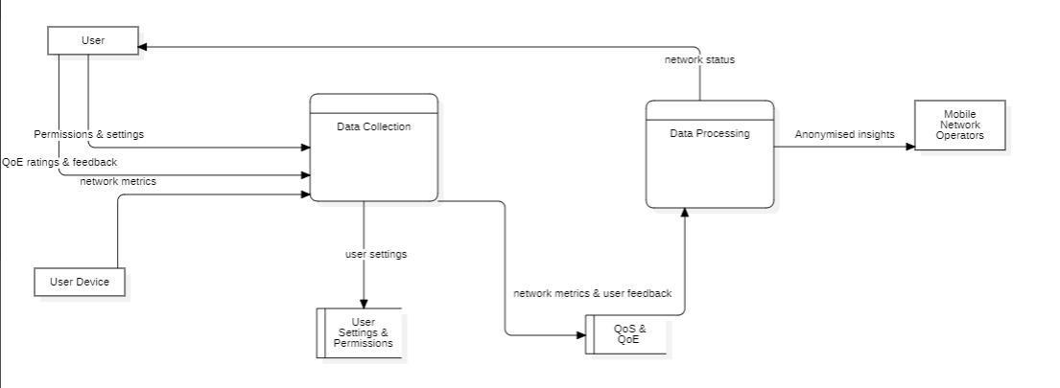
DFD -LEVEL 1
Overview
Key Components
It illustrates the data collection from mobile network operators and user devices, focusing on user feedback and network metrics.
Key components include data collection, processing phases, and QoS/QoE assessments.

Slide 11
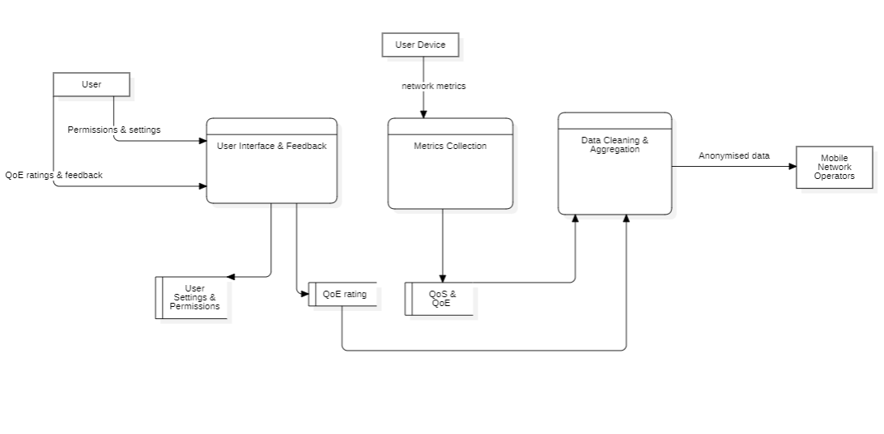
DFD - LEVEL 2

Slide 12
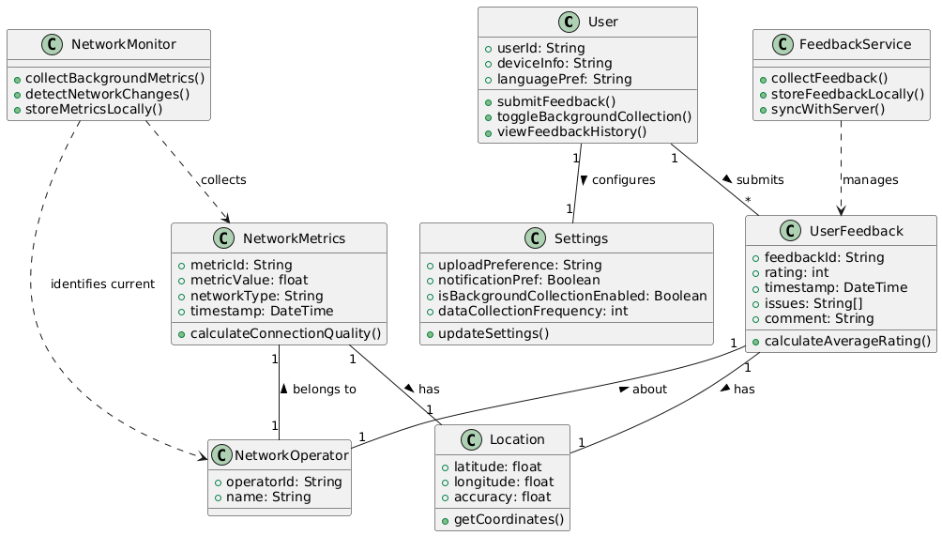
CLASS DIAGRAM
Overview
The Class Diagram outlines the application structure, defining classes like User, Settings, UserFeedback, and NetworkMetrics
Interaction
It emphasizes relationships among classes, capturing user interactions and feedback management.

Slide 13
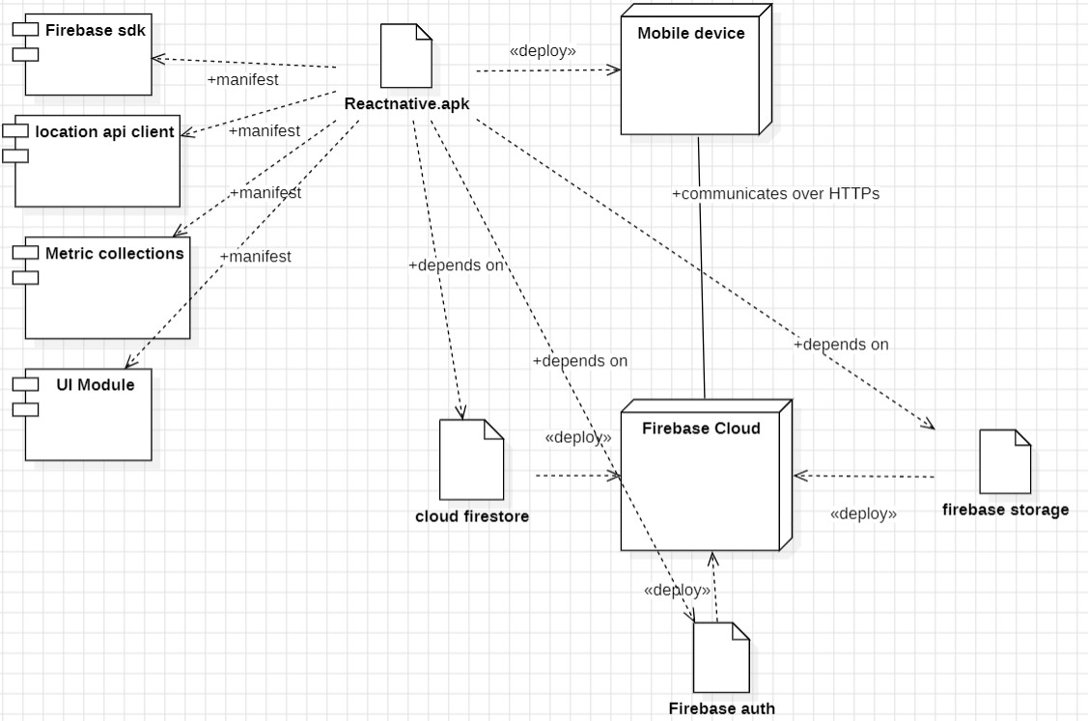
The Deployment Diagram models the physical deployment of the application on hardware.
It includes nodes such as mobile devices and Firebase cloud services.
Key components include artifacts like Firebase Authentication, Cloud Firestore, and the mobile application artifact.
DEPLOYMENT DIAGRAM

Slide 14
Conclusion
This system design documentation provides a comprehensive architectural blueprint for the Feedback Collection Application, translating requirements into UML models that ensure architectural soundness, technical feasibility, data flow integrity, and deployment readiness, positioning the project for successful delivery and long-term evolution.

